Slide 1
Smart Shopping
Team 11:
Cameron L’Ecuyer – Class ID: 17 (Team Leader)
Sneha Mishra – Class ID: 21
Navya Pillala – Class ID: 26
Ruthvic Punyamurtula – Class ID: 30
The work has been completed under the guidance of Dr. Yugi Lee and TAs
(Rohith Nagulapati, Sidrah Junaid, Nageswara Nandigam) in
CS5551 Advanced Software Engineering,
University of Missouri - Kansas City, Spring 2018

Slide 2
Project’s purpose
Develop an application that can assist a user when they are shopping for furniture online
Our app can assist our users by allowing them to use pictures to find similar items using image recognition software
Allow the users to search products using online APIs and view furniture in Augemented reality

Slide 3
Technologies used
Android Studio for developing the Android application
Unity 3D for developing the Augmented Reality part of the application
Google Cloud Vision for image recognition
Indix Product Search API for searching for products online
BMI API for use with suggestions
MongoDB for Tweet data storage
Twitter API for retrieving Tweet data
Vuforia for image database modelling

Slide 4
Login And Register
New Users can register to the App.
Existing User can login using registered
Email ID.
Optional login option to the user using
Twitter Credentials.
Firebase is used for Authentication as
well as storage.

Slide 5
Image Recognition
The User has the following options:
Click Image using Camera
Import existing image from the gallery
Skip the Image Analysis
Analyze the uploaded image
Shop for the product using the Image analysis
Google Vision is used to analyze the uploaded image

Slide 6
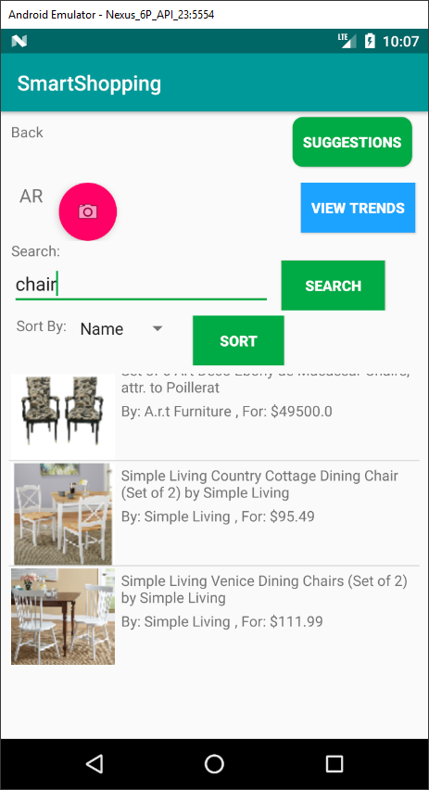
Shopping
Powered by Indix Product Search API
Indix API allows for searching of a variety
of different products
Draw back: limited data that is available, such
as limited number of images
Data is retrieved from Indix API using Google
Network Framework – Volley
Flexible searching
Sorting is done in code

Slide 7
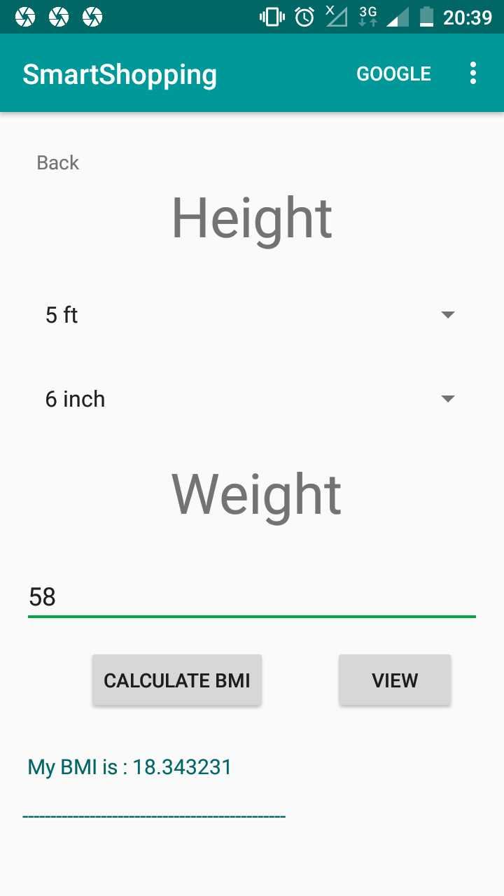
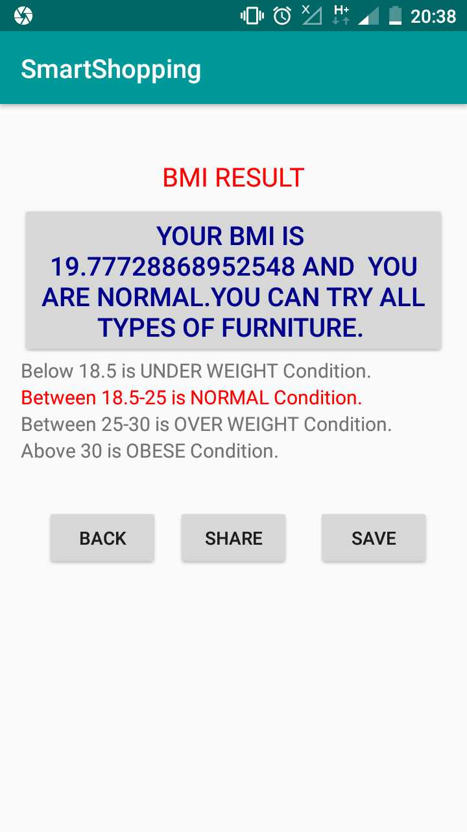
Suggestions
On clicking the suggestions button the user will get suggestions which are suitable for them.
The BMI of the user will be calculating by taking height and weight of the user as a input.

Slide 8
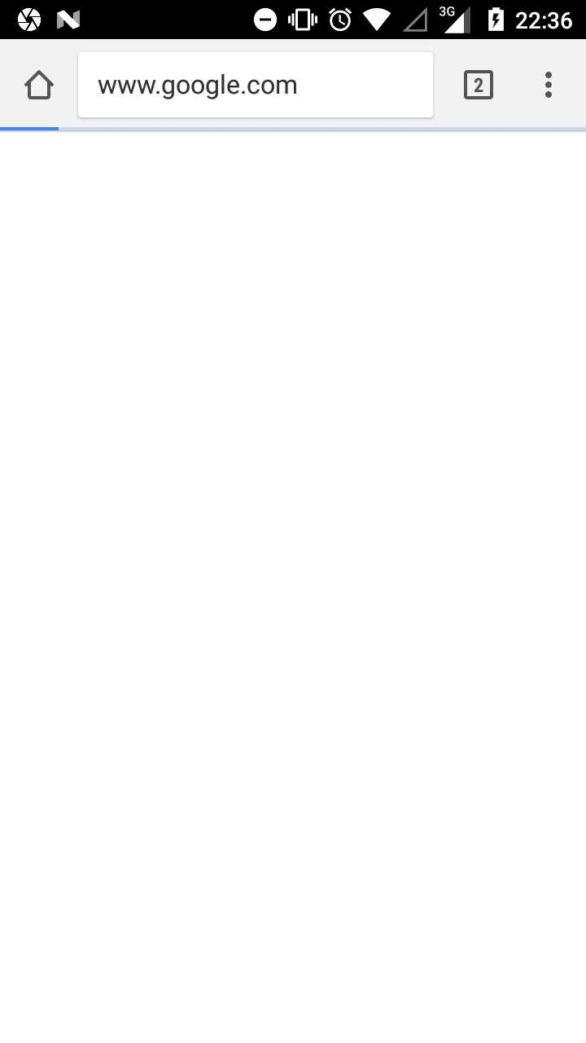
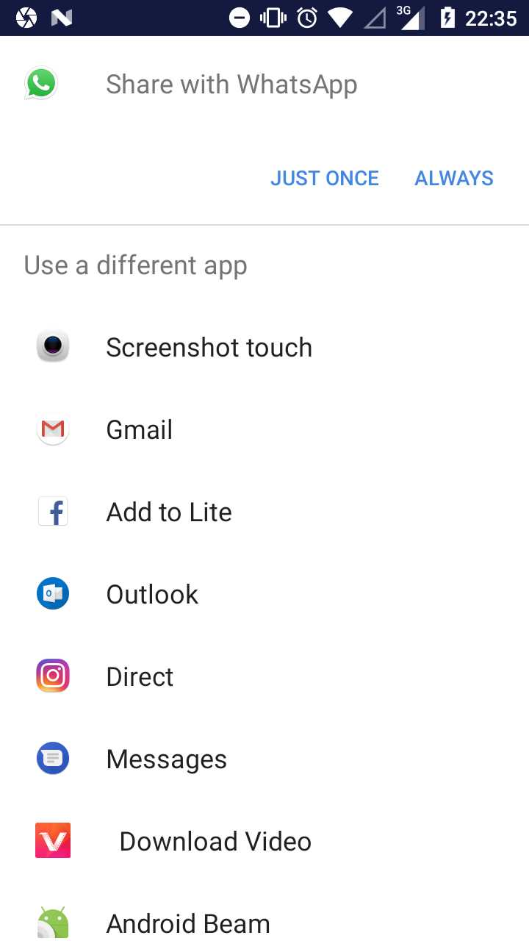
The user can also save the records for further usage by clicking the save button.
The user can also share the results to social media.
And also He can search the google by navigating to google.

Slide 9
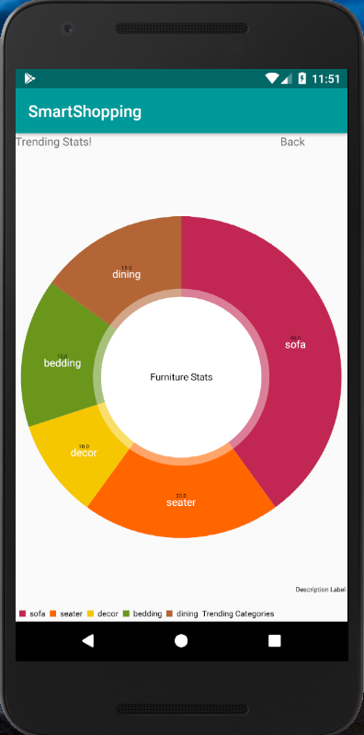

TRENDS
Collected Tweets using twitter4j-Stream, twitter4j-async
Stored the furniture trends into mongo DB
Used mongo-java-driver to support the integration
in android
Retrieved the data from the mongo DB to visualize
using Do-nut charts
https://www.letsintern.com/blog/intern-worthy-skills-how-to-develop-research-and-analysis-skills/

Slide 10
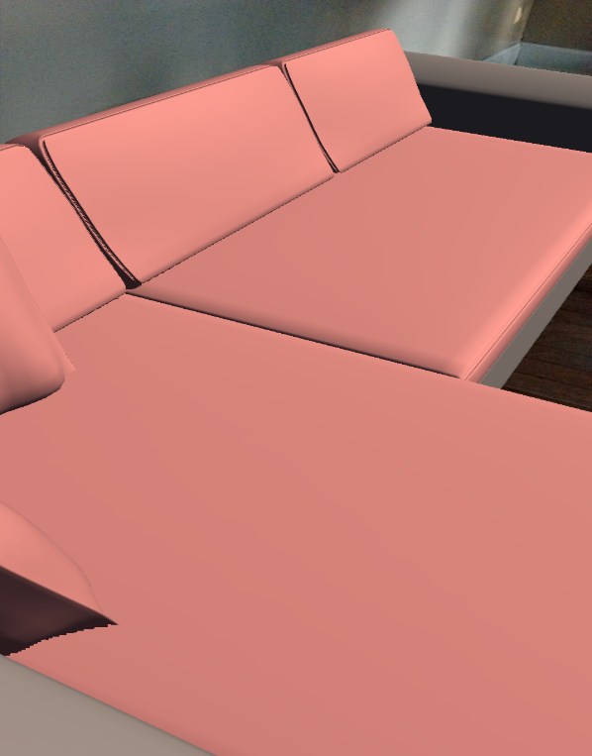
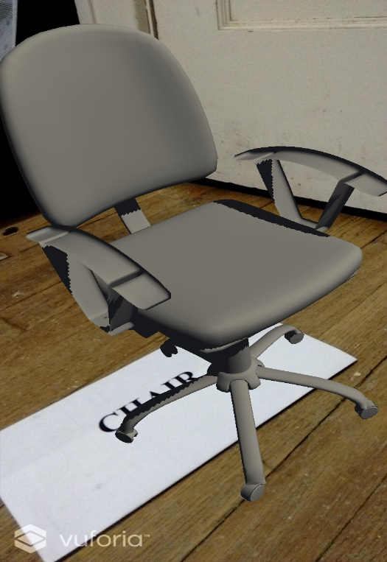
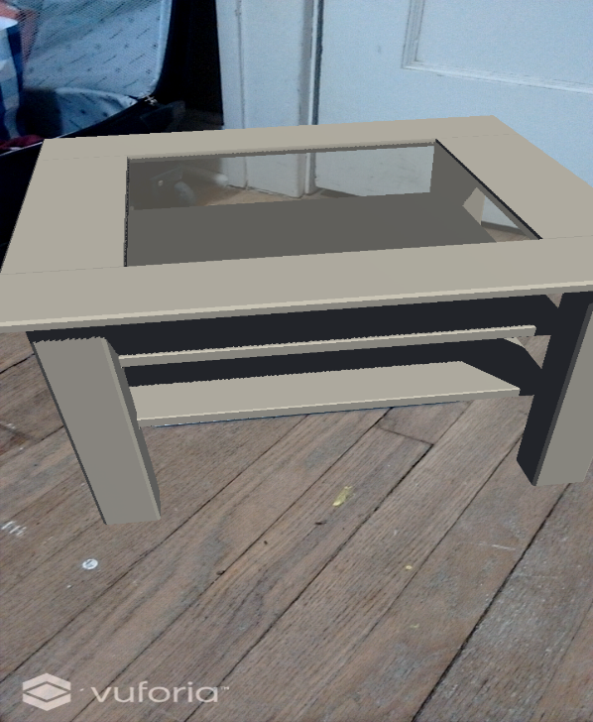
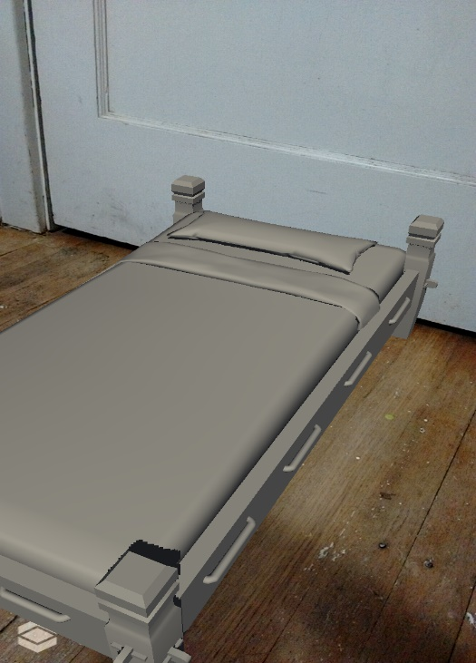
Augmented Reality
Created a Unity scene using
Vuforia image modelling
Created own markers to display
varied categories of furniture
3D – models of furniture

Slide 11
Future Work
Real time 3D image modelling
Sharing the results/content between unity and Android
Speech to text search
Including other categories of products – One Shopping App
The Demo video is available here -
https://www.youtube.com/watch?v=wyObDwxgtMU&t=1s
Thank you
- Team 11

Slide 12














Process and Technologies used
Social Media Trends
Login/Register
Augmented Reality
Image Analysis
Shopping
Camera/Gallery
Suggestions
Social Media Sharing

